Slide 1
Do Unemployment Rate and Education Level Play Big Parts in Economic Crime？
-- ANLY 506 Exploratory Data Analytics
-- Members: Yanan Tan, Jinyue Zhu
Yuwei Gao, Nipun Sodhi, Mingyu Wang

Slide 2

What we are trying to explore...
Although the crime rate has decreased sharply since early 1990s (John Gramlich, p.2), various types of crime cases are still happening everyday, putting people’s safety into danger.
There are a number of different kinds of crimes have been mentioned in the dataset, but for our project, we will mainly focus on robbery specifically.
We are trying to explore whether certain education level would relate to robbery, or whether certain unemployment level would relate to robbery.

Slide 3
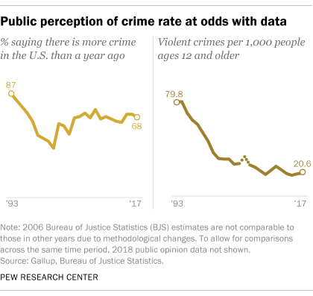
Background
Interesting phenomenon: people’s perception of crime actually increases even though the actual crime rate drops significantly
Therefore, people’s perception isn’t necessarily the truth. We target to use the data set provided to us to reveal the actual correlation and relationship between unemployment rate, education level and the crime rate.

Slide 4
Literature Review
Many people have researched about the connection between unemployment rate, education level and crime.
Scorcu and Cellini (1998) found unemployment to be a significant explanatory variable for theft in their time-series analysis
Employed individuals tend to commit fewer crimes than those who are unemployed (Witte and Tauchen, 1994).
Higher education leads to more opportunity of higher income, which increases the cost of crime (Lochner and Moretti, 2004)
But high education may decrease the probability of getting caught, which increase the crime rate (Lochner and Moretti, 2004)

Slide 5
Methodology
We have identified the columns of data that are related to our topic, and cleaned the data.
We have applied principle component analysis on the raw data to test the correlation among different variables.
We have also used different plots to visualize the data, which could provide good insights on whether there are certain relations among different variables.
We have applied clustering on the data, to further explore the relationships among the variables.
If we found possible correlations among the variables, we will try to apply correlation analysis to further explore and quantify the relationships.

Slide 6
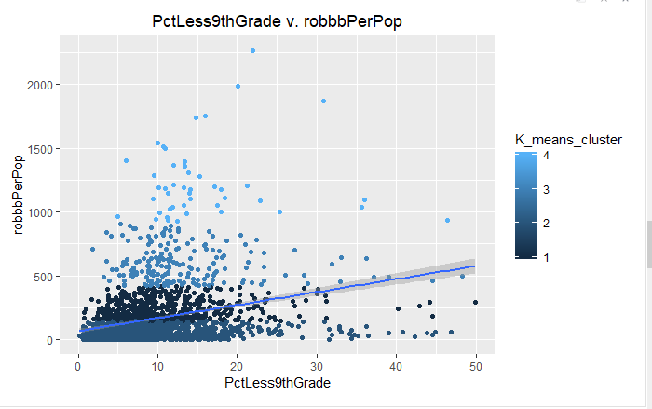
Robberies VS. Education
Robberies VS. Education Less than 9th Grade

Slide 8
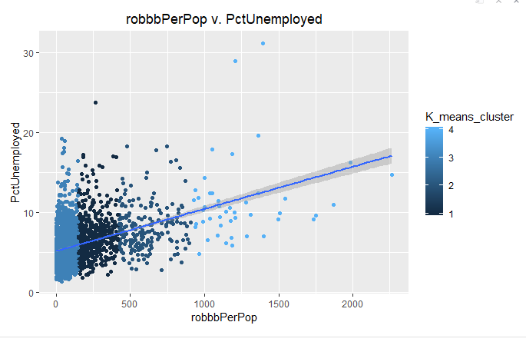
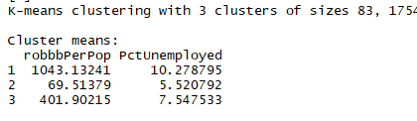
Explore the data (plots)
Robberies VS. Unemployed

Slide 9
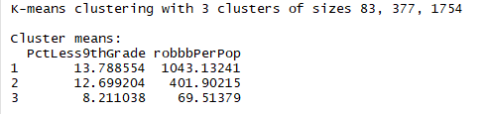
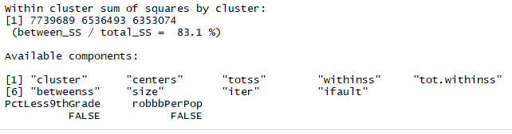
Kmeans- Results

Slide 10
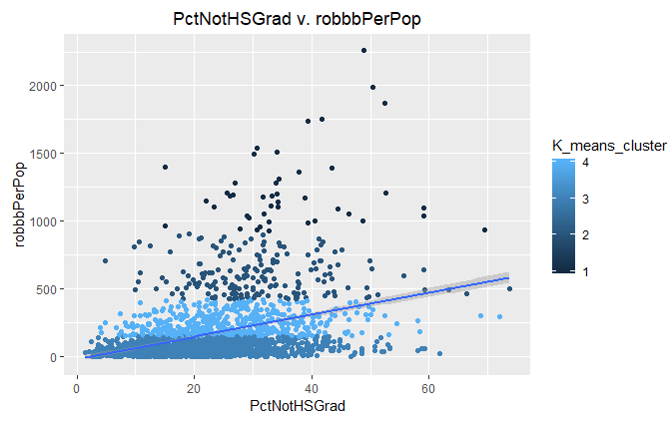
Continued..
Robberies VS. Education which not graduate from high school

Slide 11
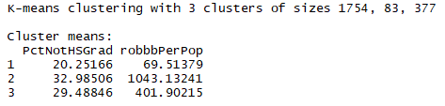
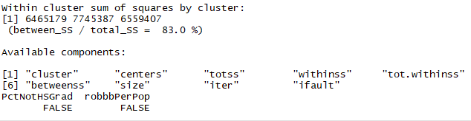
Kmeans- Results

Slide 12
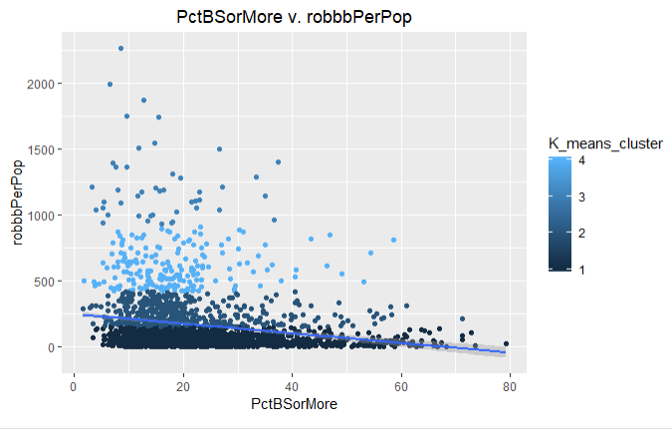
Continued..
Robberies VS. Education
People who have Bacheler Degree or Higher

Slide 13
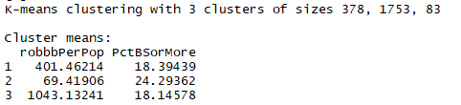
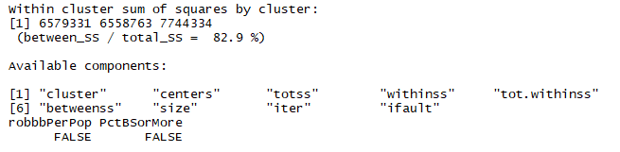
Kmeans- Results

Slide 14
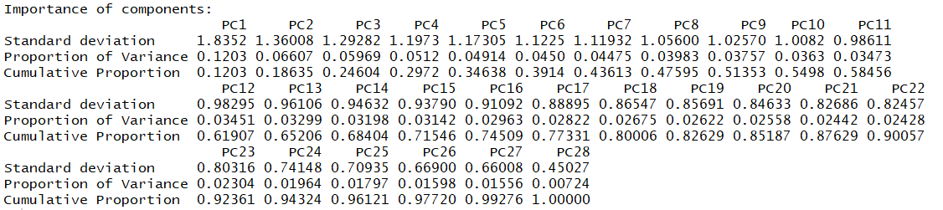
Principle Component Analysis-2

Slide 15
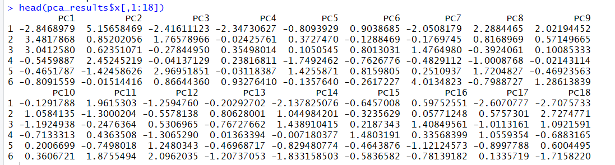
Scaling for first 18 components

Slide 16
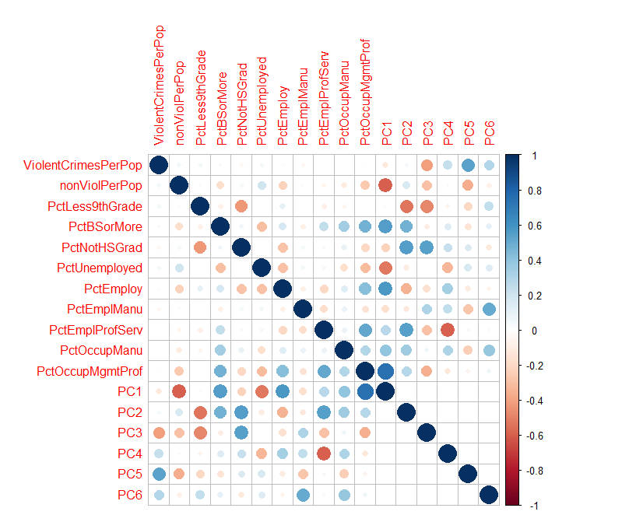
Correlation Plot- PCA
As can be seen for the first 6 components that explain 40% of the variance, the important factors are PctBSorMore, PctEmploy, PctOccupMgmtProf, NonViolPerPop etc.

Slide 17
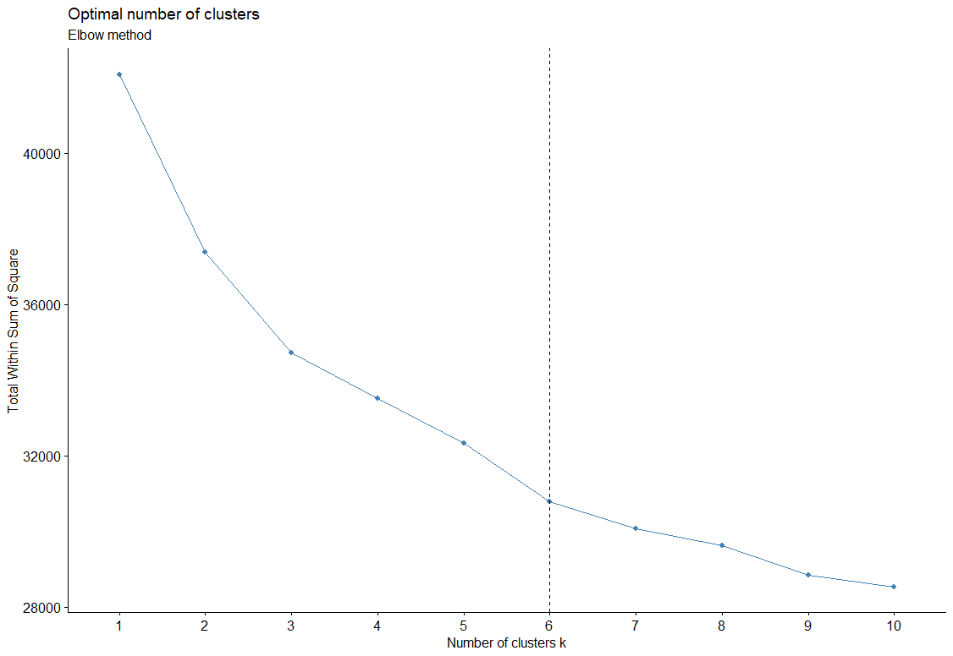
Kmeans- Finding the optimal number of clusters..
Using the elbow method we can see the 6 is the optimal number of clusters for the given data set containing the following factors
1)ViolentCrimesPerPop 2)PctLess9thGrade 3)PctBSorMore 4)PctNotHSGrad 5) PctUnemployed

Slide 18
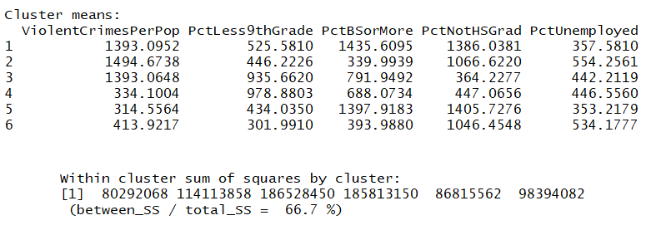
Kmeans- Results

Slide 19
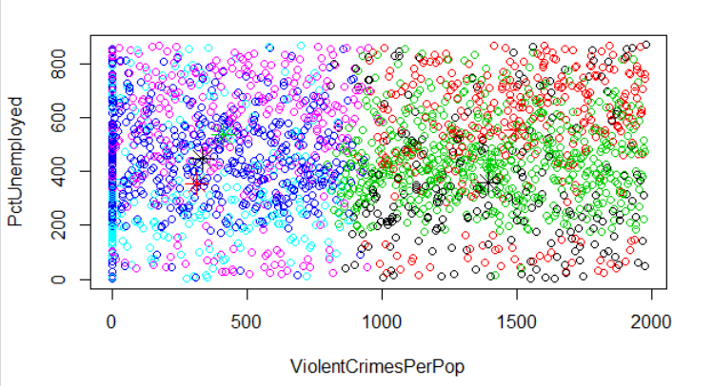
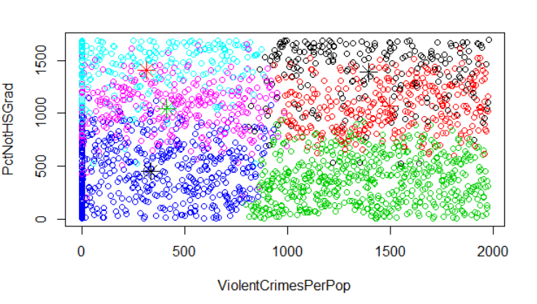
Kmeans- Results

Slide 20
Results
The results show that unemployment rate is positively correlated with the number of robbery.
Percentage of people whose education level is less than 9th grade is positively correlated with the number of robbery.
Percentage of people whose education level is lower than 9th grade is positively correlated with the number of robbery.
Percentage of people whose education level is lower than high school is positively correlated with the number of robbery.
Percentage of people whose education level is more than sophomore is negatively correlated with the number of robbery.

Slide 21
Limitation
Data Cleaning:
We experienced a large number of missing or abnormal values in the dataset, which would have negative effects on our analysis.
Unable to obtain the average value.
Solution:
We decided to omit the entire row/column.
na.omit
apply(unemploy, 2, function(x) any(is.na(x)))

Slide 22
Conclusion
We successfully applied pre-processing and data exploration techniques that we obtained from class.
Based on the analysis results, we could conclude that there’s relationship between percentage of residents’ education levels/unemployment rate and the number of robberies.
The higher percentage of people in the communities are unemployed, the more robberies
The higher percentage of people in the communities have received certain level of educations (9th grade, high school and sophomore), the less robberies
Work in Progress: Status Report, Consolidated Final Report.

Slide 23
Reference
National Council for Crime Prevention (2001), Brottsutvecklingen i Sverige: 1998–2000 (Trend Analysis of Crime in Sweden, 1998–2000), Stockholm.
Witte, A. D. and Tauchen, H. (1994), Work and Crime: An Exploration Using Paneldata, National Bureau of Economic Research, Cambridge, MA.
Lochner, L. and Moretti, E. (2004), The Effect of Education on Crime: Evidence from Prison Inmates, Arrests, and Self-Reports, The American Economic Review, 94(1): 155-189.

